Slide 1
Kindly find the editable link to my Google spreadsheet below
https://docs.google.com/spreadsheets/d/1nY15qdmEyBKHpn6U3r2lNpuu9sCwR1qZeYPNIeGX9P8/edit?usp=sharing

Slide 2
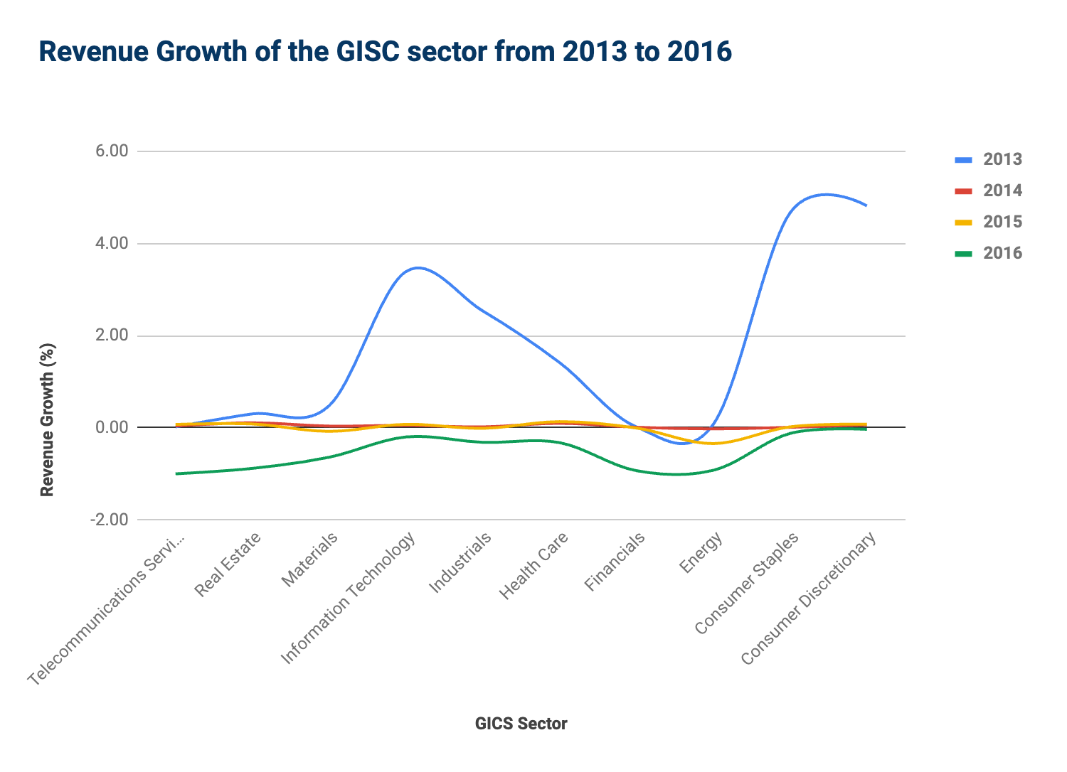
Revenue Growth of the GISC sector from 2013 to 2016 and Quantitative Insights
All the companies in the GISC Sector all experienced decrease in the revenue growth from 2013 to 2016.
The Energy, Consumer Staples and Consumer Discretionary had the highest total revenue Range of about $1.2 Billion which also reflects on this line chart looking at the range between 2013 to 2016.
The 3 sectors listed above also showed more variability than the others with a standard deviation greater than $500 Million with the rest of the sectors falling short.
These 3 sectors have showed similarities in terms of their Range and Variability asides from the fact that Consumer Staples and Consumer Discretionary are positively skewed due to the Mean being greater than the Median while the Energy sector joined the other sectors apart from the Telecommunication services in being negatively skewed.

Slide 3
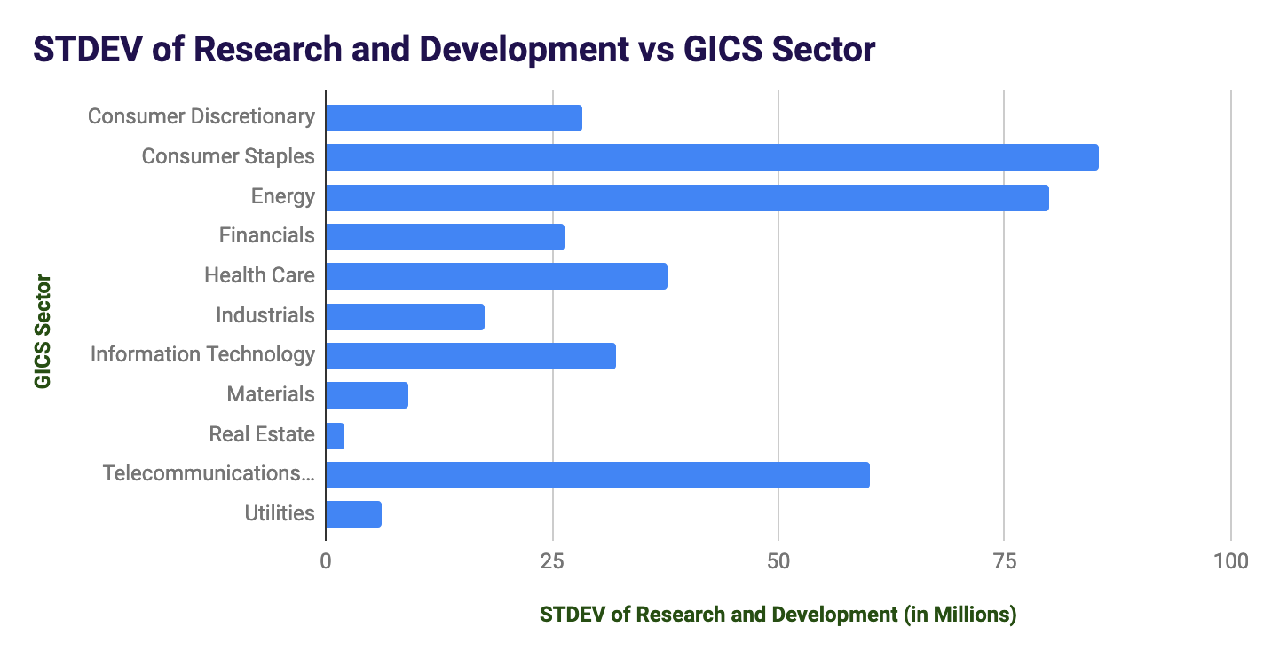
Variability of GICS Sector in Research and Development
The consumer staples, Energy and Telecommunication services have shown more variability crossing over 50 million in Standard Deviation.

Slide 4
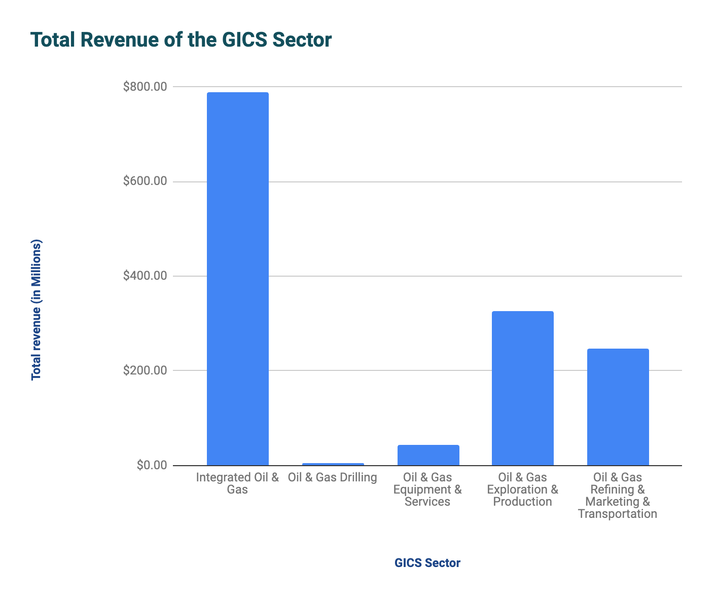
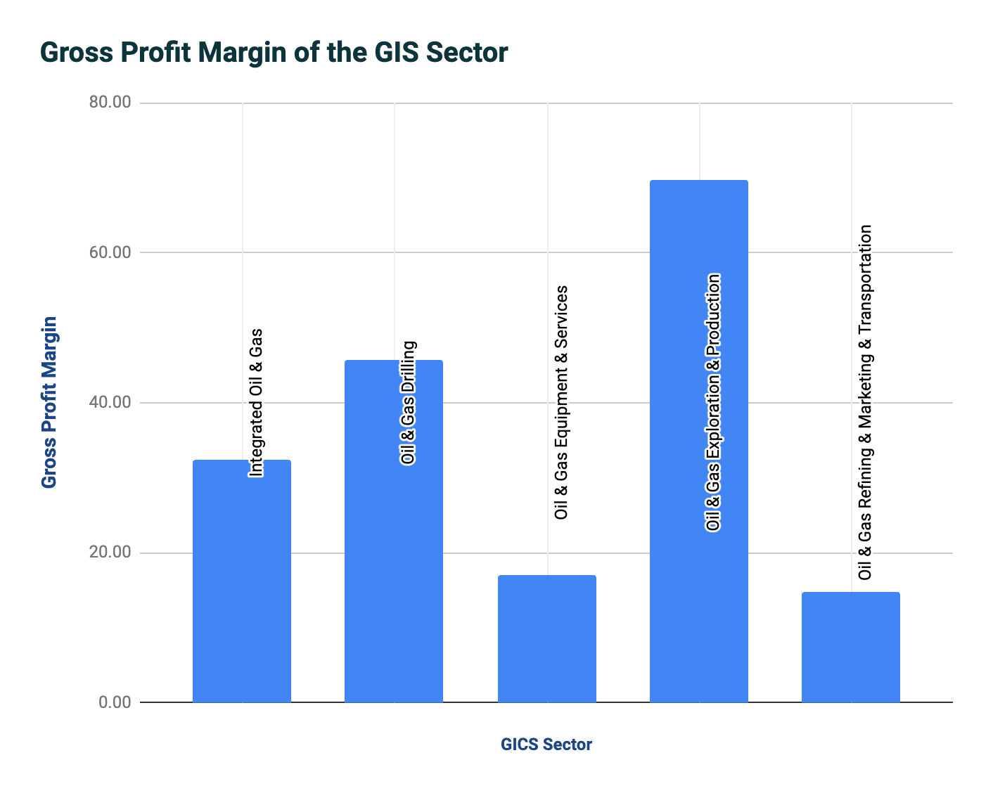
Total Revenue and Gross Profit Margin of the Energy Sector
Oil & Gas Drilling had the least Revenue in USD but had the second highest Gross Profit Margin which indicates that Oil & Gas drilling are improving in terms of profitability than Integrated Oil & Gas, Oil & Gas Equipment and Oil & Gas Refining.
In summary, increase in revenue generated does not always translate to increase in profit.

